Slide 1

WIKIPEDIA Web Traffic
Time Series Forecasting
Presenters:
Kamiya Sargoch
Desen Liu
Madhavi Polisetti
Notes:
Forecasting future web traffic for approximately 145,000 Wikipedia articles.

Slide 2
Agenda
Introduction
Model Selection
Data
Experimental Results
Initial Data Analysis
Conclusion
Plots
Future Work

Slide 3
Introduction
Business Objectives
Wikipedia
Internet marketing initiatives
Search engine optimization (SEO)
Manage Traffic overload
Multilingual, web-based, free encyclopedia
Openly editable and viewable content
Problem Statement
Can we accurately forecast web traffic for a given page based on history of daily Views?
Is Google trend a useful feature for our forecasts?
Notes:
Wikipedia is a free encyclopedia, written collaboratively by the people who use it.
Business objective - advertising budget dollars.

Slide 4
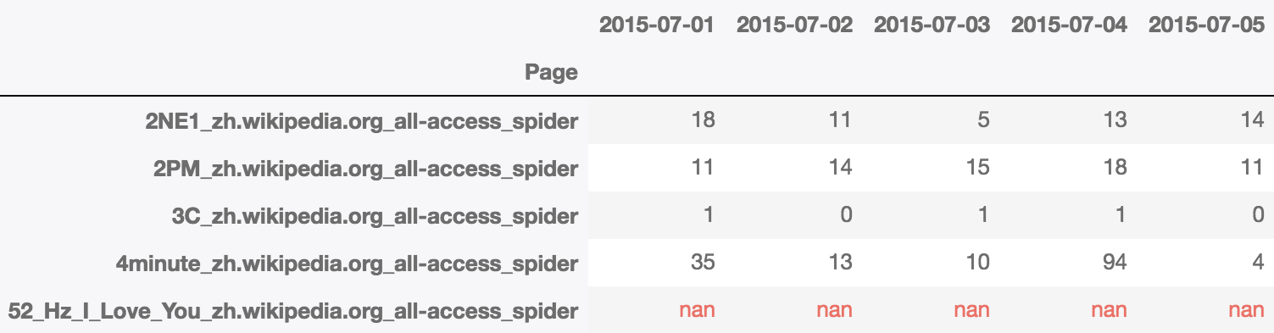
Data
145k Time Series data
Time Series features:
Daily views of each Wikipedia article
Static features :
Page or Article Name
Type of Traffic - Mobile, Desktop etc.
Metadata - Language and User-agent
Notes:
Each of these time series represent a number of daily views of a different Wikipedia article, starting from July, 1st, 2015 up until December 31st, 2016.
The data contains 145k time series in two separate files:
*train_1.csv* holds the traffic data, where each column is a date and each row is an article,
*key_1.csv* contains a mapping between page names and a unique ID column
Each page name contains the Wikipedia project (e.g. en.wikipedia.org), type of access (e.g. desktop) and type of agent (e.g. spider). which means that each article name has the format: 'name_project_access_agent' (e.g. 'AKB48_zh.wikipedia.org_all-access_spider').

Slide 5
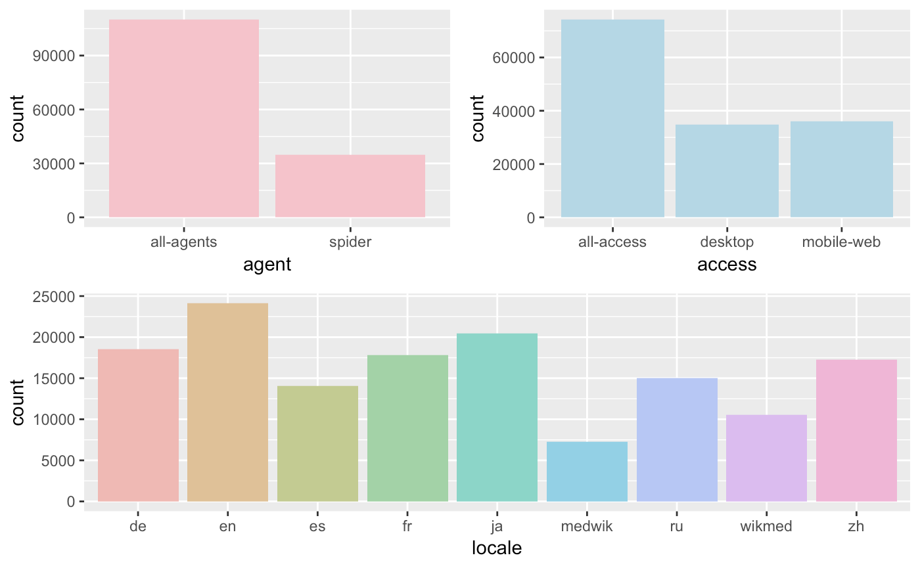
Initial Data Analysis
7 languages: German, English, Spanish, French, Japanese, Russian, and Chinese.
Mobile sites are slightly more frequent than desktop ones.
Notes:
Preprocessing before initial data analysis (Extra)
-Visualize timeseries and extract meta data
Data analysis
Count - *wikipedia* data includes 7 languages: German, English, Spanish, French, Japanese, Russian, and Chinese. Highest english.
( All of those are more frequent than the *mediawiki* and *wikimedia* pages)
Access - Mobile sites are slightly more frequent than desktop ones.

Slide 6
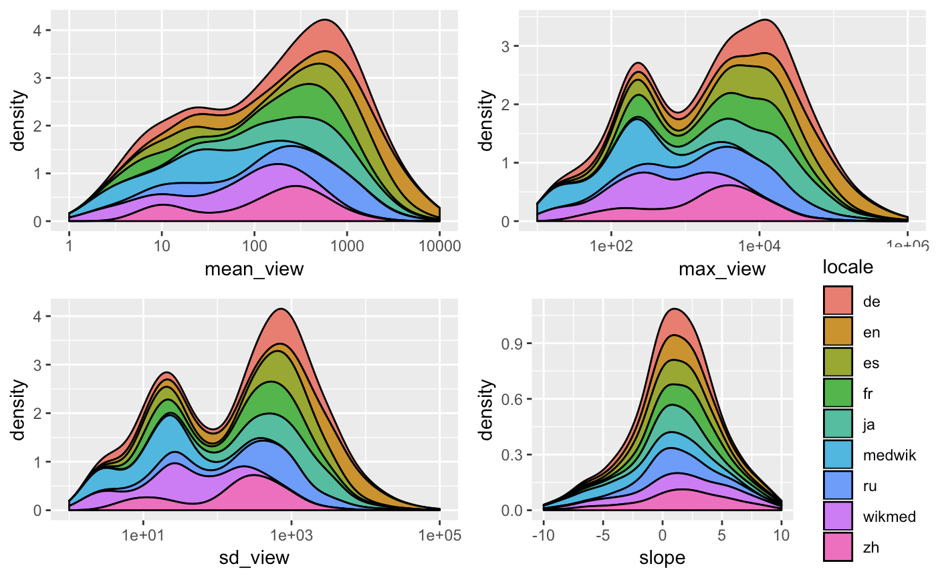
Plot(s)
Notes:
Parameters visualized - mean, standard deviation, amplitude, and a the slope of a naive linear fit
Distribution of views in various languages:
Less variation in Chinese pages (corresponds to zh in pink). High variation in English (mustard)/German pages.
The linear relationship between views and time Or Trend is overall non-existent..
Two peaks in views - One around 10 and then about 300 views or so.
- The distribution of average views is clearly bimodal, with peaks around 10 and 200-300 views. Something similar is true for the number of maximum views, although here the first peak (around 200) is curiuosly narrow. The second peak is centred above 10,000.
- The distribution of standard deviations (divided by the mean) is skewed toward higher values with larger numbers of spikes or stronger variability trends. Those will be the observations that are more challenging to forecast.

Slide 7
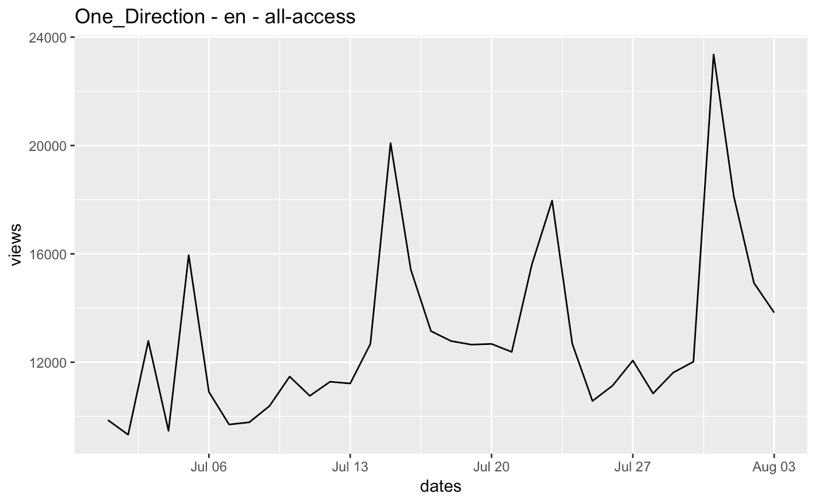
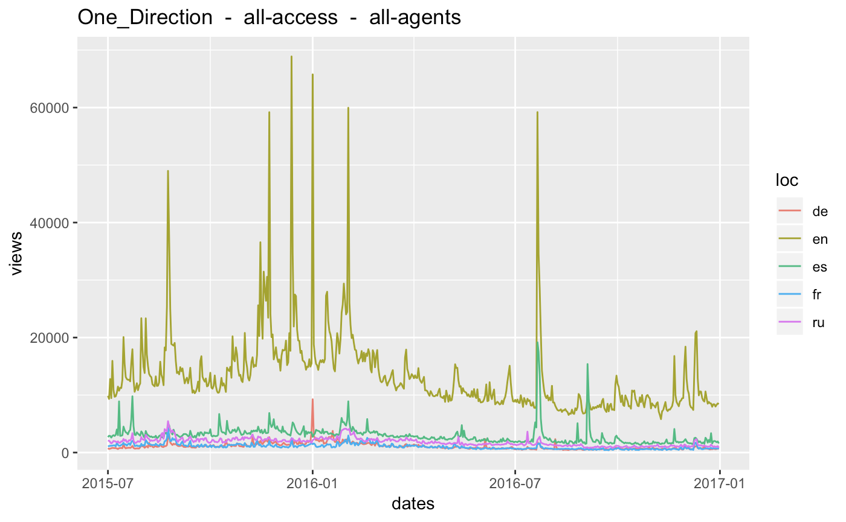
Plot(s)
07/01/15
01/01/2017
Notes:
Time plots of a specific article for all the available languages.
This one is “One Direction”. We explored some of the “Boy Bands” pages..
As we zoomed in, we see weekly seasonal pattern. troughs in weekend and peaks in mid-week.

Slide 8
Model Selection
Choice of Models and Metrics
Metric - MAE
Daily Page Views
Exponential smoothing
Holt Winters(2)
sARIMA
Google Trend Data
Daily Page Views
ARIMAX
ML+ARIMA
Notes:
Here is a brief flow of things for the project :
Data: One Direction wiki page daily views
Our Goal 1 -> 4 models
Our Goal 2 -> google trend + 2 models
Metric: train/test validation, RMSE, MAE````

Slide 9
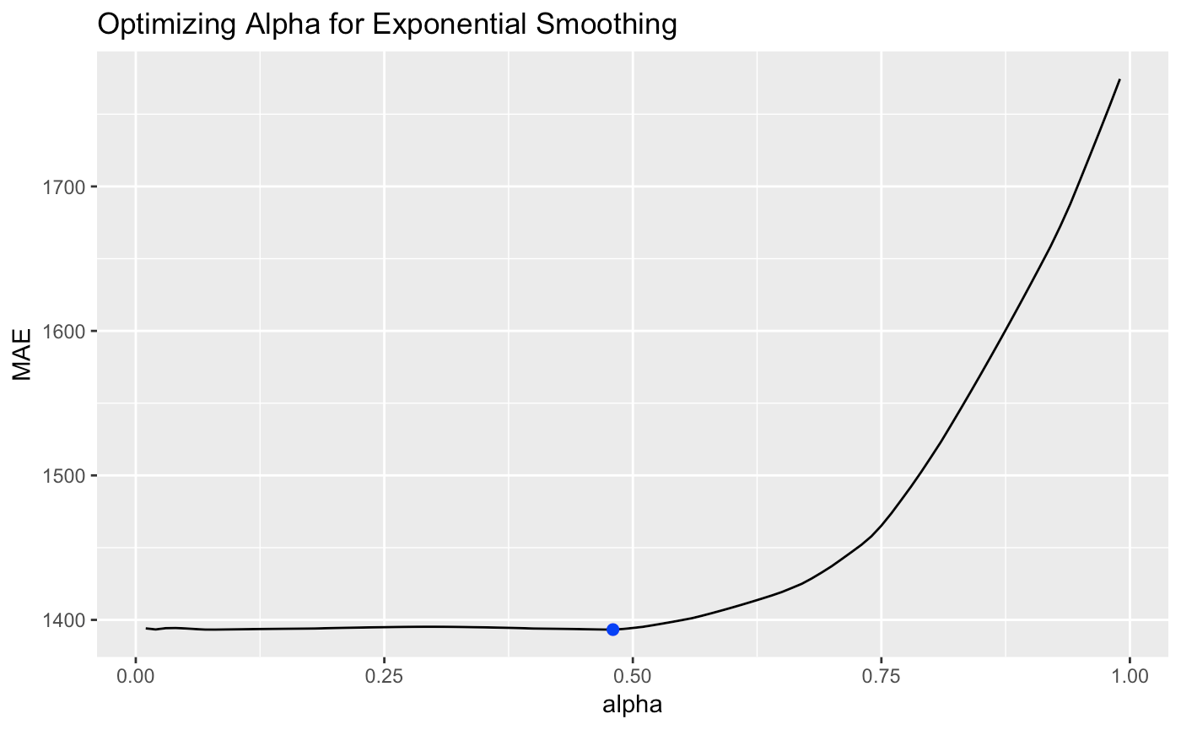
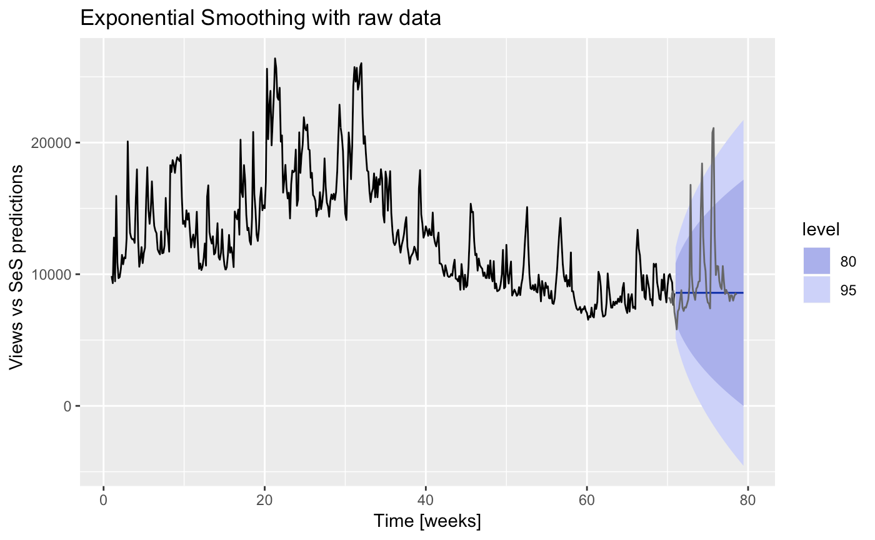
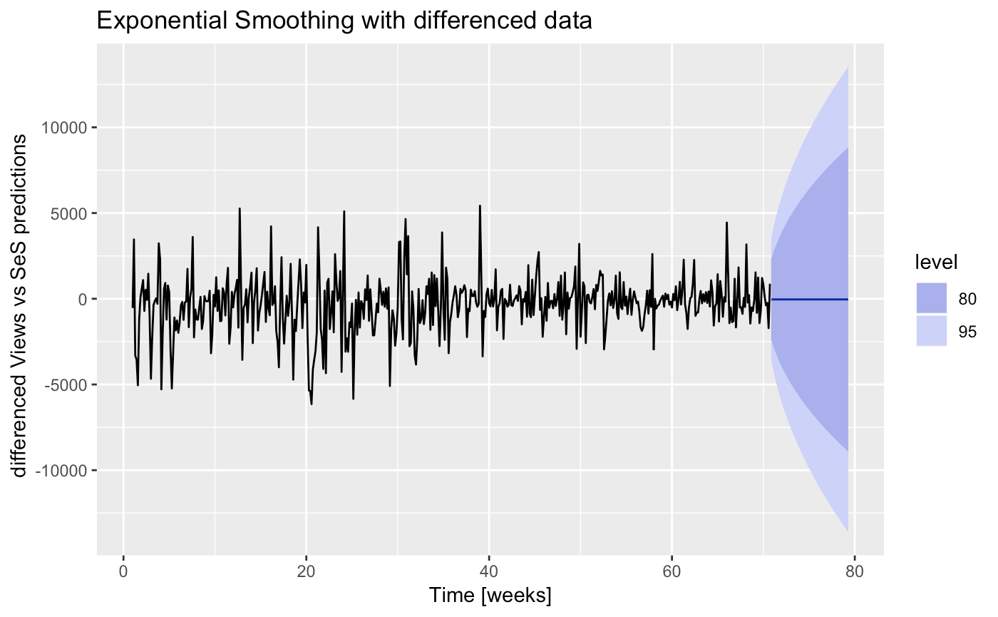
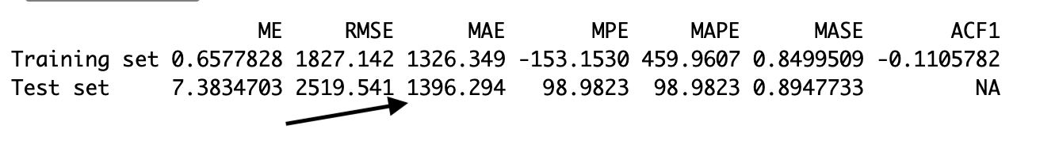

Exponential Smoothing
Notes:
Exponential smoothing - weighted averages on previous observations.
Optimized Alpha
Raw data, Differenced data, accuracy
allows for weighted averages where greater weight can be placed on recent observations and lesser weight on older observations.
We fit Exp smoothing with raw data - That didn’t provide very accurate forecasts.
Then we did a differencing on the data .
We looked for optimal alpha.
Resulting forecats were much better.

Slide 10
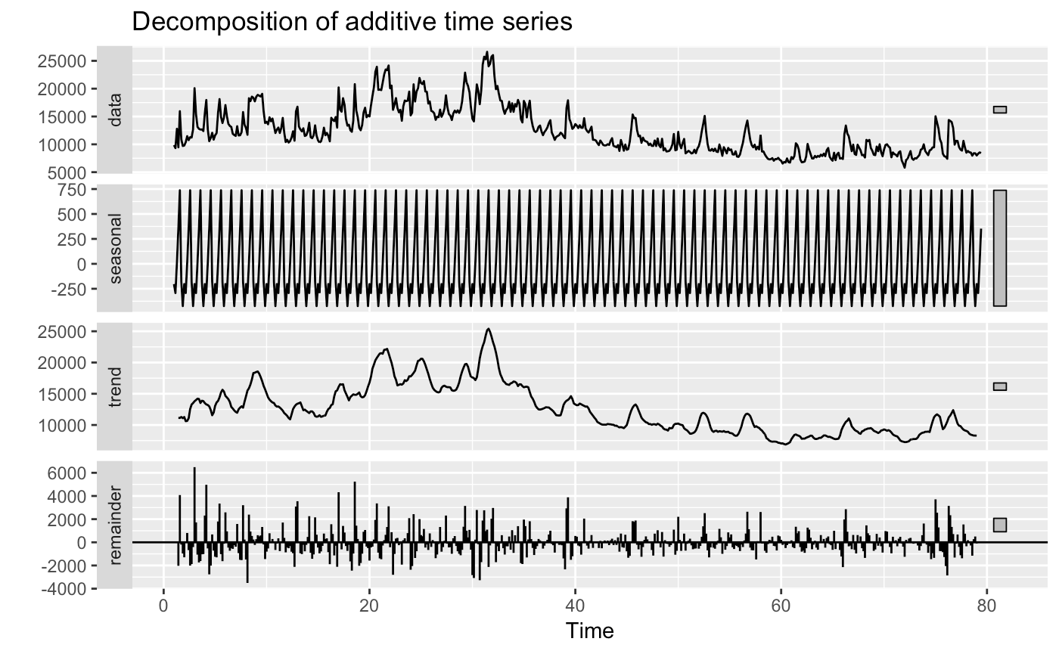
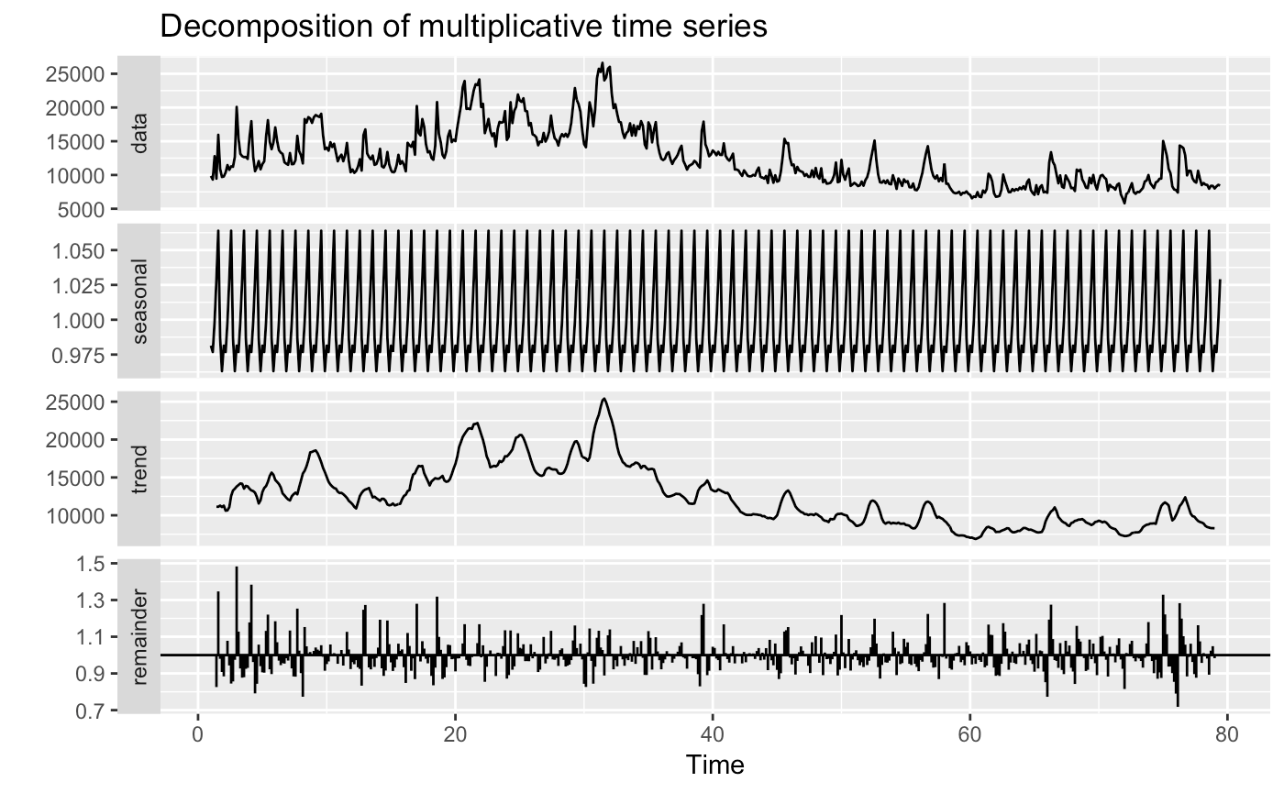
Experimental Results
(Holt Winters )
‘Additive’ Decomposition
‘Multiplicative’ Decomposition
Notes:
To make predictions using data with a trend and seasonality, we turn to the Holt-Winters Seasonal Method.
Decomposed data
Mult model

Slide 11
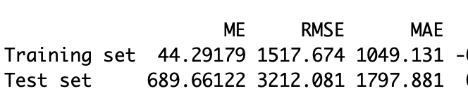
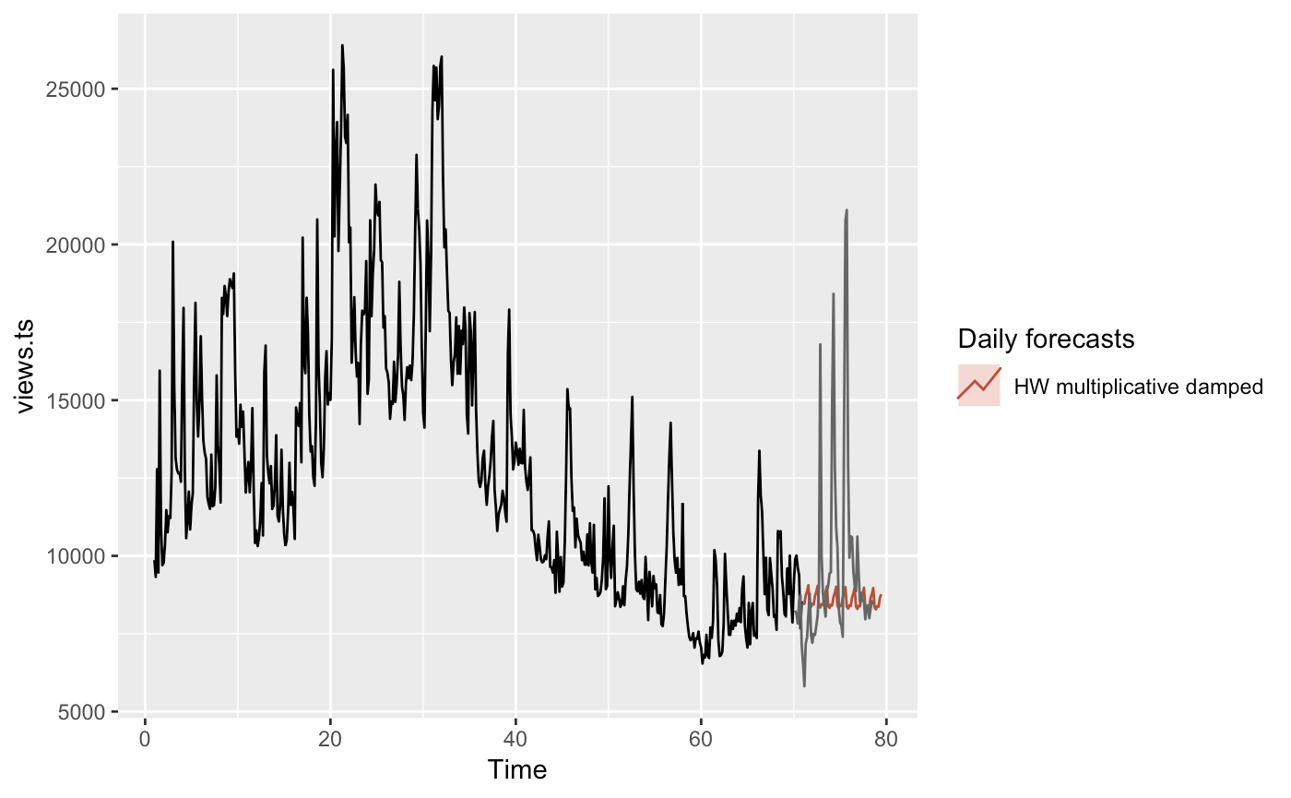
Experimental Results
(HoltWinters) - hw function

Slide 12
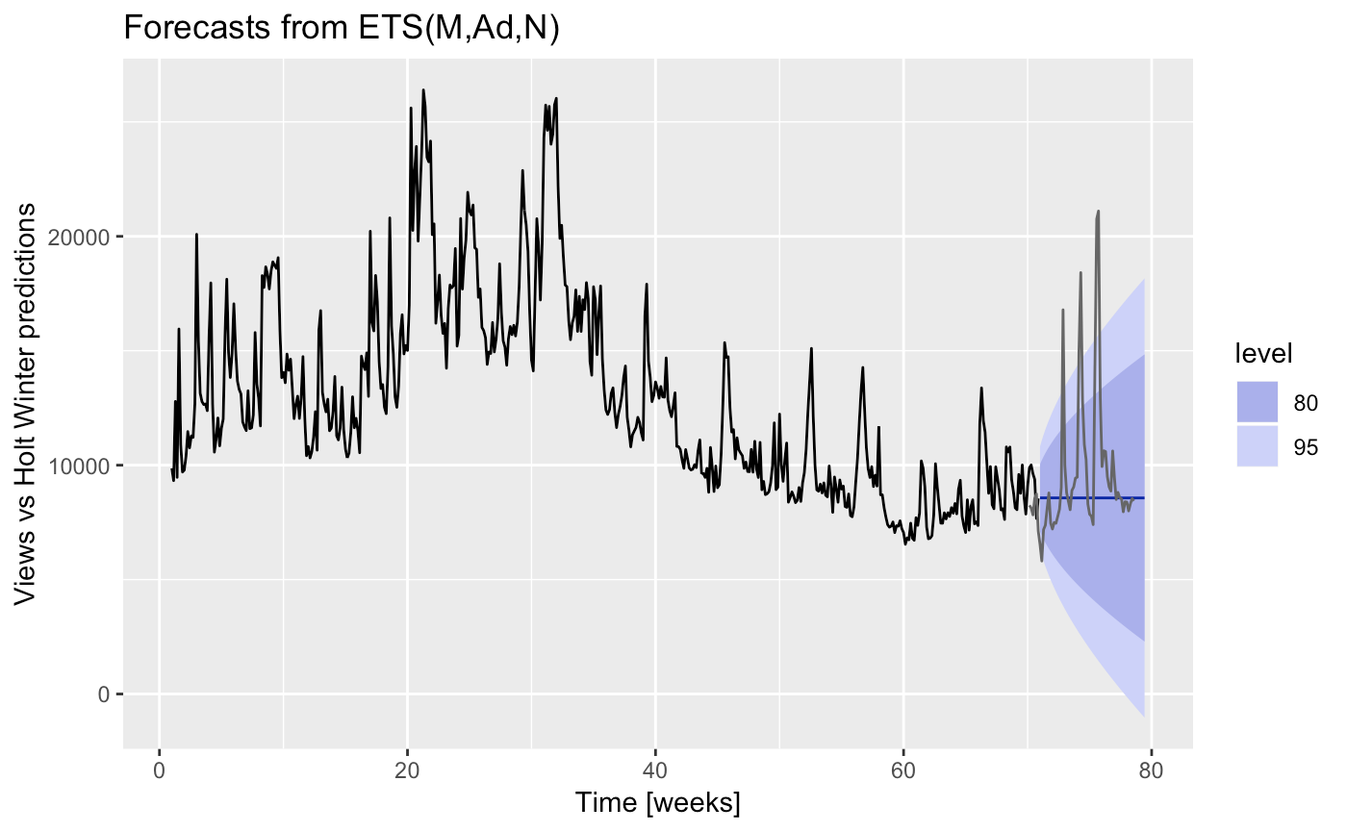
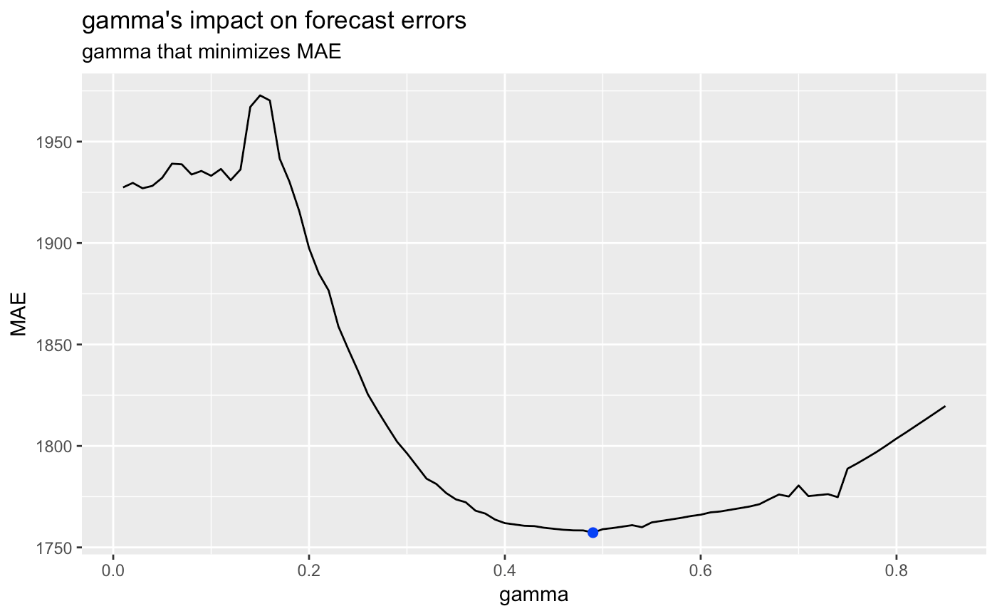
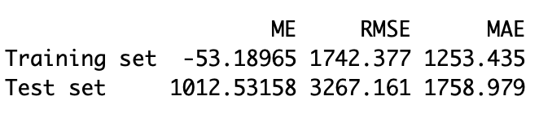
Experimental Results
(HoltWinters) - ETS function.
Notes:
αα, ββ, and γγ are the three smoothing parameters to deal with the level pattern, the trend, and the seasonality, respectively. Optimized gamma.

Slide 13
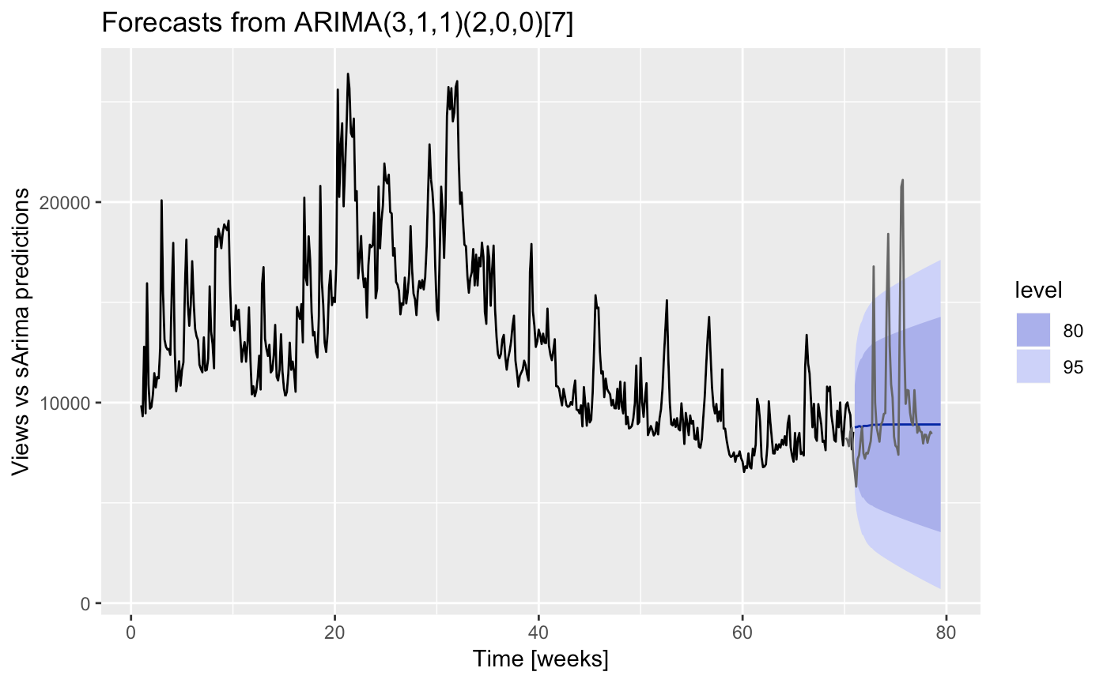
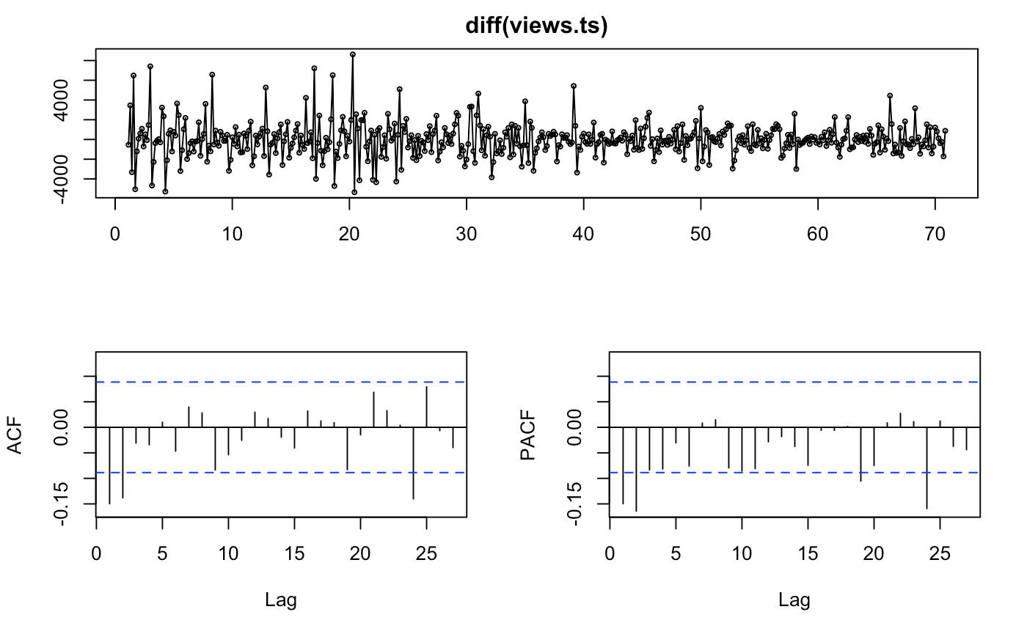
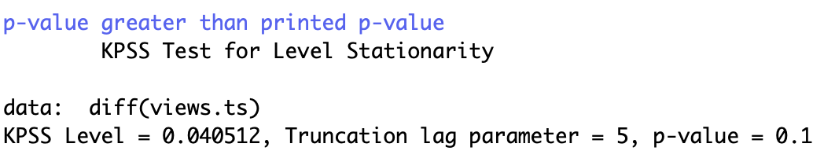
Experimental Results
sARIMA
Notes:
Then we turn to sARIMA.
The result is not stationary.
We do a regular differencing to handle the trend and that leaves us stationary series.
Fit manual sARIMA (2,1,2) (2,1,0)

Slide 14
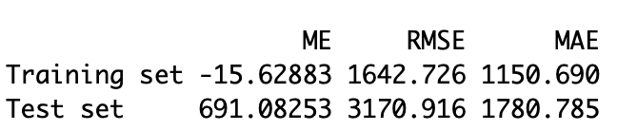
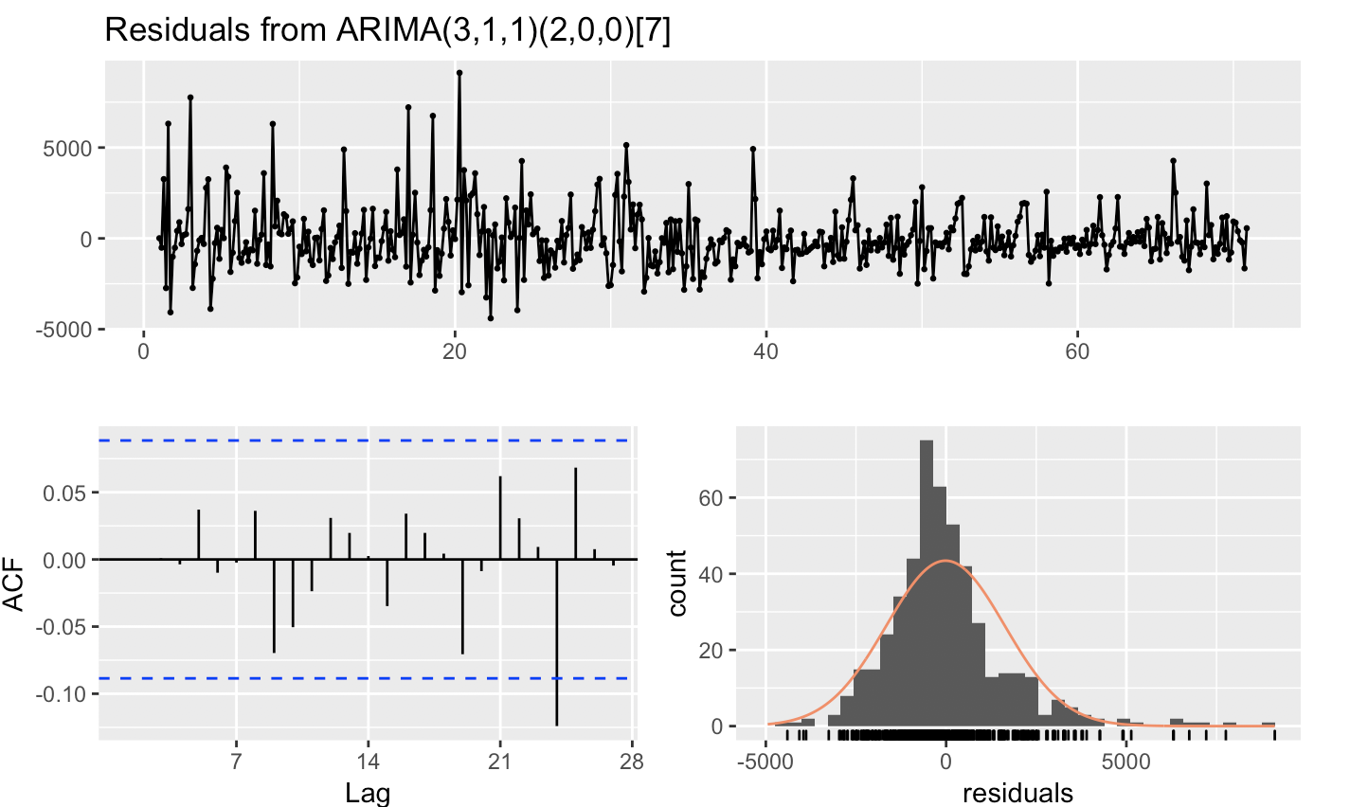
Experimental Results
sARIMA Contd..
Notes:
αα, ββ, and γγ are the three smoothing parameters to deal with the level pattern, the trend, and the seasonality, respectively.

Slide 15

Experimental Results
(ARIMAX)

Slide 16
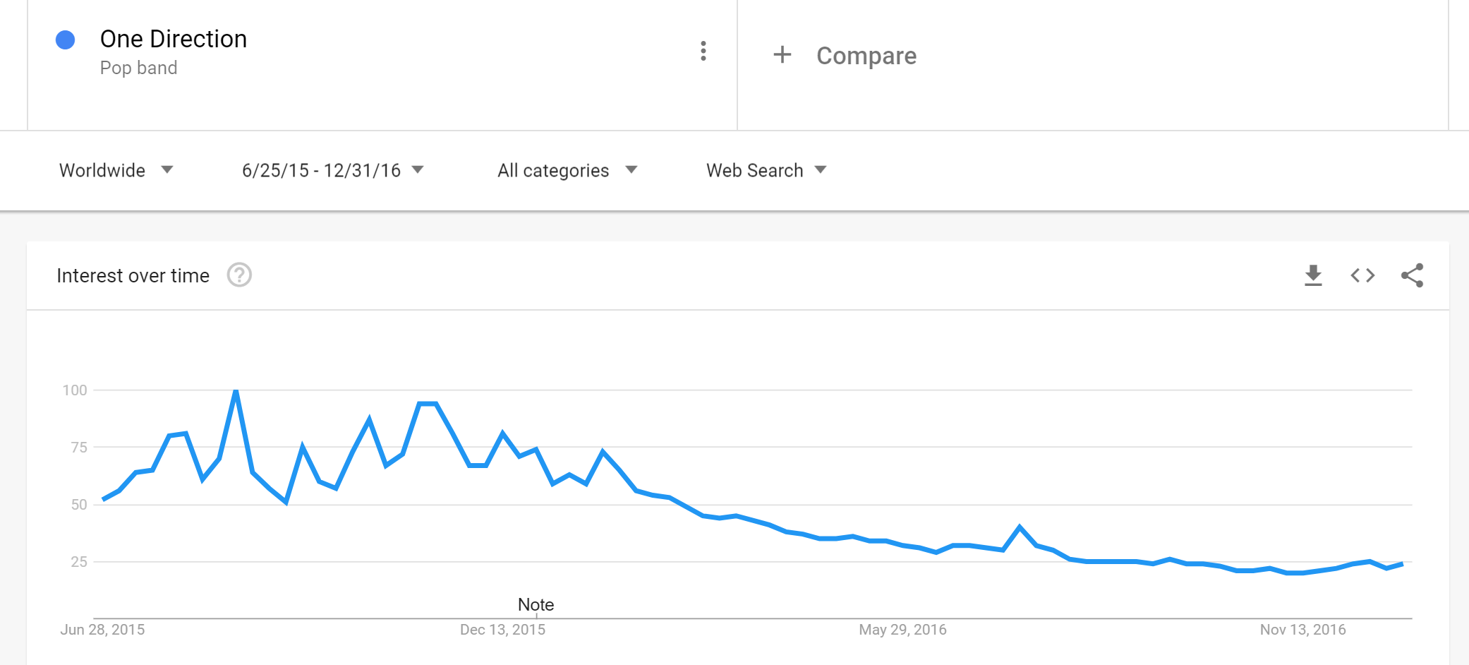
Experimental Results
(ARIMAX)

Slide 17
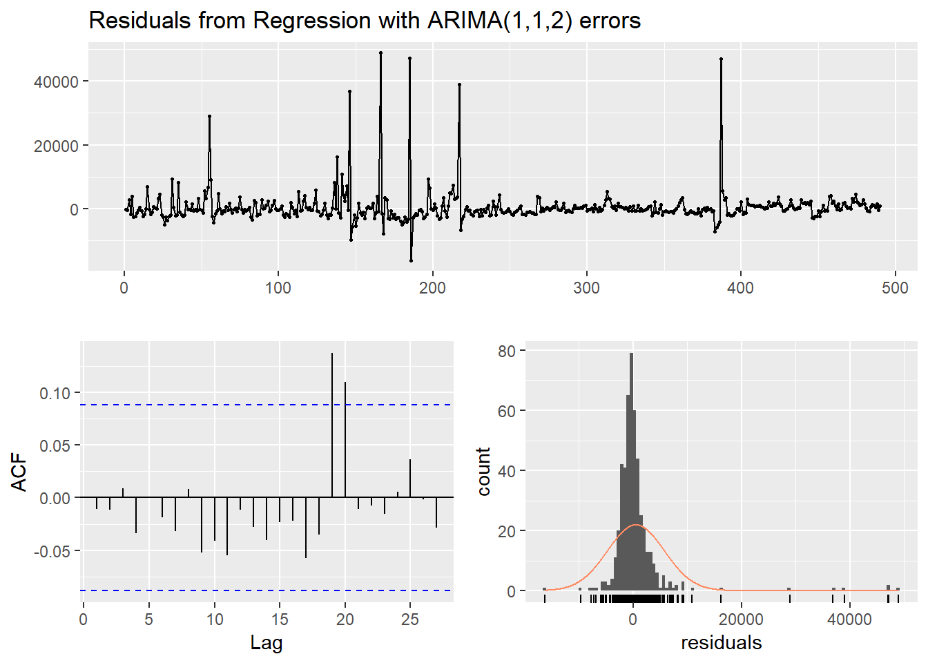
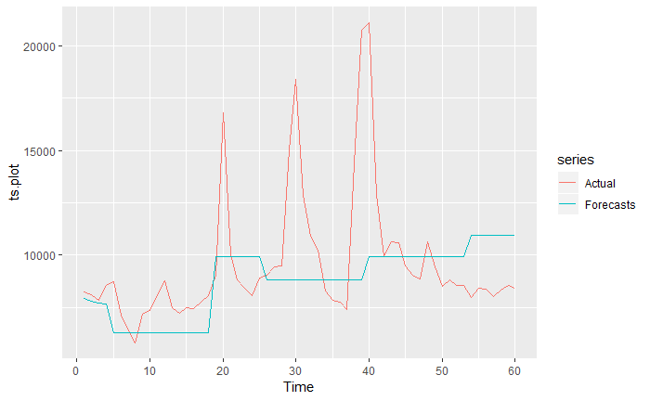
Experimental Results
(ARIMAX)
 | RSME | MAE
Train | 5307.827 | 2213.331
Test | 3195.666 | 2042.739

Slide 18
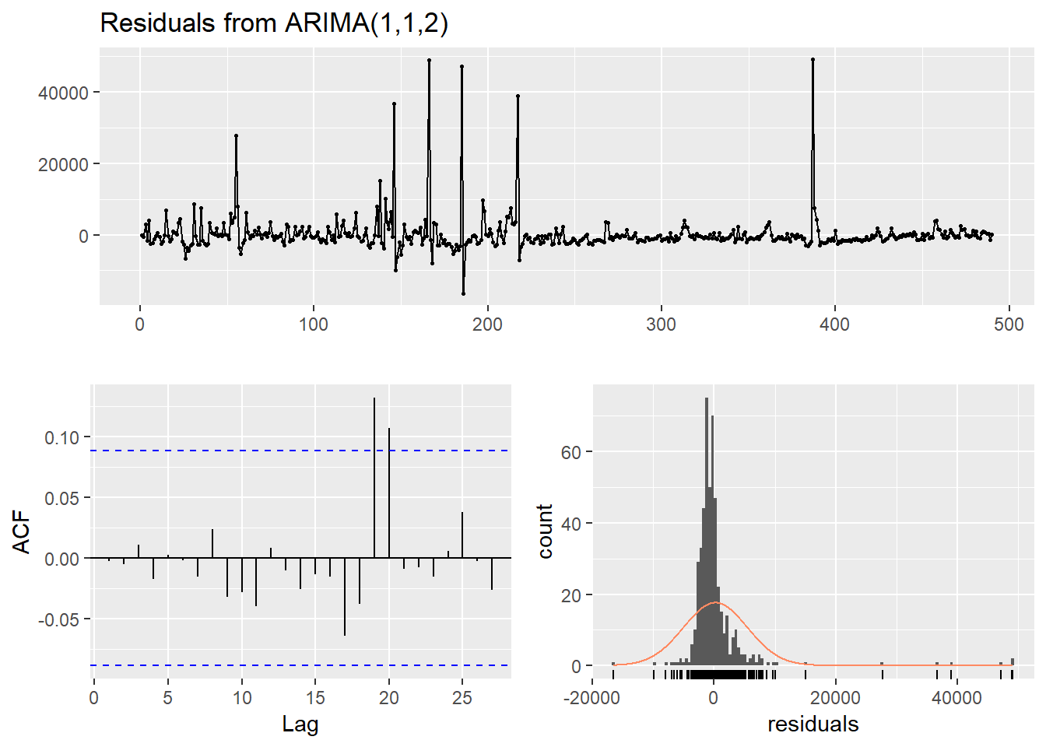
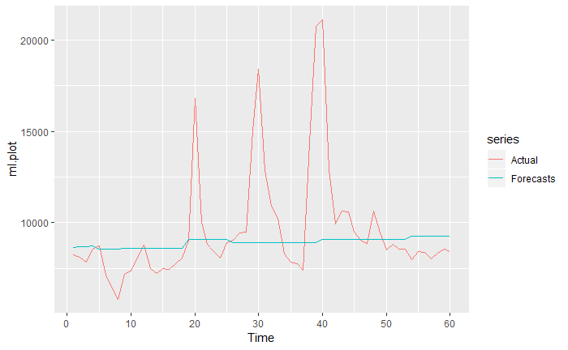
Experimental Results
(ML + ARIMA)
 | RSME | MAE
Train | 1555.316 | 1294.756
Test | 3125.479 | 1754.003

Slide 19
Conclusion(s)
1
ARIMAX is considered the best model.
3
Spikes(outliers ) are extremly hard to catch.
Google trend is useful for our forecasts.
2
ML + ARIMA errors performance are on par with ARIMAX.
4

Slide 20
Future Work
Advanced methods such as cointegration, RNNs and LSTM for more accurate predictions.
Use of metadata to cluster data and expand the models to work with the whole dataset.
Other data source(s)
Other advanced methods
Forecasts for Full Dataset
A few other data sources that we might look to include are Google news, Word Tracker and Keyword Spy.

Slide 21
Thank You!

